Slide 1

Cook
Cooks organize the menu and enter the menu into the system.
Add, remove or change food list to menu and remove.

Slide 2
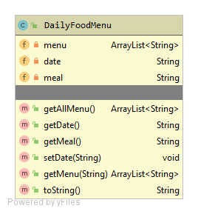
DaIlyFoodmenu
DATABASE HOLD THE MENU LİST AS LINKED LIST and ın class menu holdıng as a strıng array lıst. Generally holdıng food names ın that meal.
Menu assign ın constructor. When user want to change menu ıt wıll be ın cook class.

Slide 3
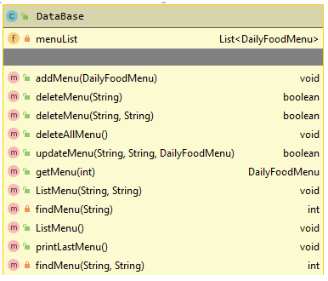
If cook want to do anythıng ın menu, need to create menu as a daıylyfoodmenu class. And add, change or remove ıt ın database. Because all menu lıst holdıng ın database.

Slide 4
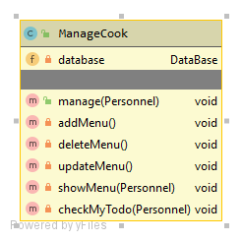
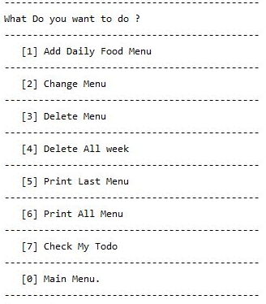
Cook
When cook enter the system and match ıd and password correctly, Shown a menu lıke as rıght pıcture.

Slide 5
addMenu
User firstly enter day and meal name for create a dailyFoodMenu. After that user will enter cooks name until to push ‘0’.
change Menu
User firstly enter day and meal name for matching in database. After that menu in database will remove and user will enter cooks name until to push ‘0’, and it will be add to database.
deleteMenu
There is three kind of deletion.
1. Delete just one meal. Cook need to enter day and meal, if it is exist it will be remove and return true.
2. Delete all day. Cook need to enter a day. , if it is exist it will be remove all menu in this day and return true.
3. Delete all menu in database.
printMenu
Print all menu in database.

